Slide 1
SQL Server Internals 101
Ayman El-Ghazali - @TheSQLPro
www.thesqlpro.com
Senior PFE @ Microsoft

Slide 2
Agenda
How Data is Stored: Pages & Extents
How Data is Retrieved: The Query Lifecycle
How the Infrastructure Works: Storage (HDD,SSD,RAID) & Memory
Speed Assessment

Slide 3
How Data is Stored and Organized: Pages, Extents, Allocation Bitmap Pages

Slide 4
Pages
8KB in Size or 8192 Bytes
Header is 96 Bytes
Contains:
PageID
Pointers to Previous and Next Pages
Free space
Total # of rows on the page
128 Pages = 1 Megabyte | 128,000 = 1 Gigabyte
Smallest Unit of allocation; there are no half pages

Slide 5
Pages
Warning: Actual colors may vary!
Page Header (96 Bytes)
Data Row 1 (100 Bytes)
Data Row 2 (200 Bytes)
For this example:
Row Offset 1 would have the value 96
Row Offset 2 would have the value 196 Row Offset 3 would have the value 396
Data Row 3 (80 Bytes)
3
2
1
Row offset: Distance from the first byte
in the row to the start of the page
http://technet.microsoft.com/en-us/library/ms190969(v=sql.105).aspx

Slide 6
Extent
A set of 8 Pages
1 Page = 8KB | 8 Pages = 64 KB
16 Extents per MB | 16,000 Per GB
Basic unit of space management for SQL Server data and index pages
Two Types
Mixed: contains pages owned by multiple objects (up to 8)
Uniform: all pages contained within come from one object and the entire extent can only be used by that object
MIXED_PAGE_ALLOCATION = {OFF|ON} (New for SQL 2016)

Slide 7
Allocation Bitmap Pages
The internal “directory” of information on pages
GAM
Which extents are available for allocation
Covers a 4GB interval of data
SGAM
Which mix extents have at least one page to allocate
Covers a 4GB interval of data
PFS (Page Free Space)
Used to track how much free space is on pages
Tracks other attributes as well
Covers a 64MB interval of data

Slide 8
GAM
Extent 0
GAM Page
1 | 0 | 1 | 1 | 1 | 1 | 1 | 1 | 1 | 1 | 1 | 0 | 0 | 0 | 0 | 0 | 0 | 1 | 1 | 1 | 1 | 0 | 0 | 0 | 0
1 | 0 | 1 | 1 | 1 | 1 | 1 | 1 | 1 | 1 | 1 | 0 | 0 | 0 | 0 | 0 | 0 | 1 | 1 | 1 | 1 | 0 | 0 | 0 | 0
1 | 0 | 1 | 1 | 1 | 1 | 1 | 1 | 1 | 1 | 1 | 1 | 1 | 1 | 1 | 1 | 0 | 1 | 1 | 1 | 1 | 0 | 0 | 0 | 0
1 | 0 | 1 | 0 | 0 | 0 | 1 | 1 | 1 | 1 | 1 | 0 | 0 | 0 | 0 | 0 | 0 | 1 | 1 | 1 | 1 | 0 | 0 | 0 | 0
1 | 0 | 1 | 1 | 1 | 1 | 1 | 1 | 1 | 1 | 1 | 0 | 0 | 0 | 0 | 0 | 0 | 1 | 1 | 1 | 1 | 0 | 0 | 0 | 0
1 | 0 | 1 | 1 | 1 | 1 | 0 | 0 | 0 | 1 | 1 | 0 | 0 | 0 | 0 | 0 | 0 | 1 | 1 | 1 | 1 | 0 | 0 | 0 | 0
1 | 0 | 1 | 1 | 1 | 1 | 1 | 1 | 1 | 1 | 1 | 0 | 0 | 0 | 0 | 0 | 0 | 1 | 1 | 1 | 1 | 0 | 0 | 0 | 0
1 | 0 | 1 | 1 | 1 | 1 | 1 | 1 | 1 | 1 | 1 | 0 | 0 | 0 | 0 | 0 | 0 | 1 | 1 | 1 | 1 | 0 | 0 | 0 | 0
1 | 0 | 1 | 1 | 0 | 0 | 1 | 1 | 1 | 1 | 1 | 0 | 0 | 0 | 0 | 0 | 0 | 1 | 1 | 1 | 1 | 0 | 0 | 0 | 0
1 | 0 | 1 | 1 | 1 | 1 | 1 | 1 | 1 | 1 | 1 | 1 | 1 | 1 | 1 | 1 | 1 | 1 | 0 | 1 | 1 | 0 | 0 | 0 | 0
Tracks 64,000 Extents (4GB)
1 Represents if that extent is free
Extent 250

Slide 9
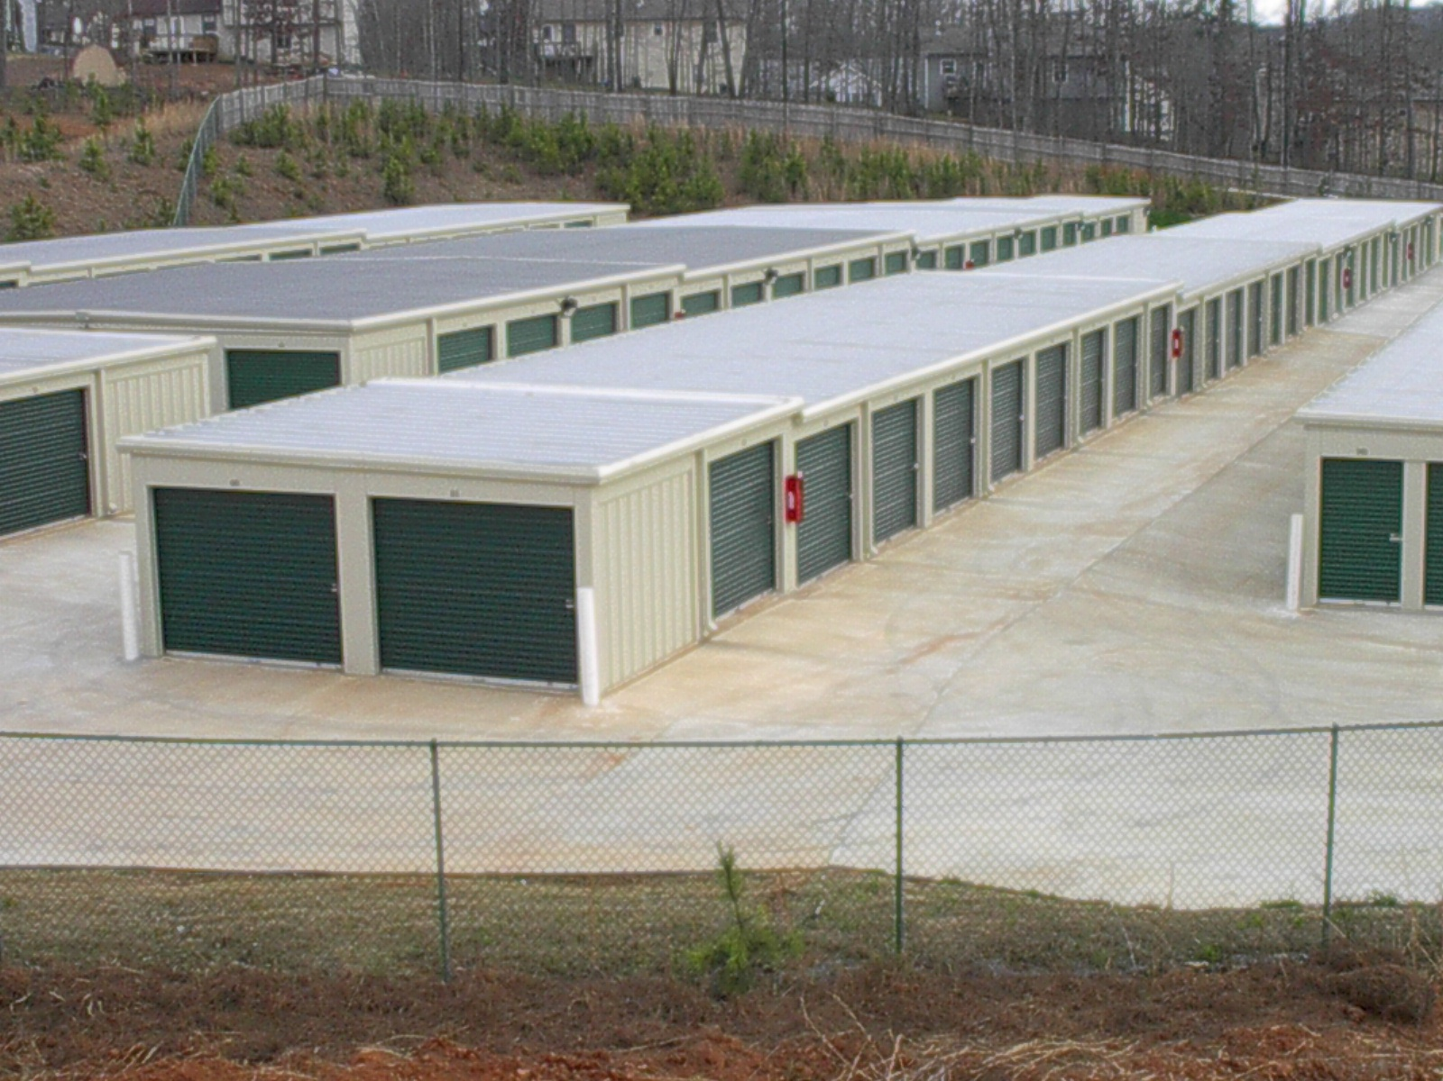
Any Free Storage Space Available?
http://storage-rental.co/wp-content/uploads/2013/04/2.jpg

Slide 10
Index Allocation Map (IAM)
Special internal page on a data file that tracks all extent allocations for tables, indexes, and partitions
Basically, lets SQL Server know what extent belongs to what specific entity
Covers a 4GB interval of data

Slide 11
Uniform Extents
Mixed Extent
Table3
Extent 1
(Table1)
Extent 2
(Table2)
IAM1
IAM2
SGAM
Extent 3
(Table1)
GAM
PFS
Allocation Bitmaps

Slide 12
Does it sound Greek?
PFS, GAM and SGAM help SQL Server determine where free space is and how much so that it can allocate it appropriately without having to scan all the pages
IAM pages and indexes help SQL Server fulfil queries
The take away is that these few pages help keep an internal “directory” for SQL Server to be able to find what it needs quickly and pull back as few pages as necessary
It’s all about reduction of cost to the system

Slide 13
The Query Lifecycle
Client
Query Engine
Storage Engine
Storage
(RAM or HD)
Query Engine

Slide 14

RAM
CPU
North Bridge
(Memory Control)
FSB
VIA DMA
SATA/SAS PCI-E
South Bridge
(I/O Control)

Slide 15
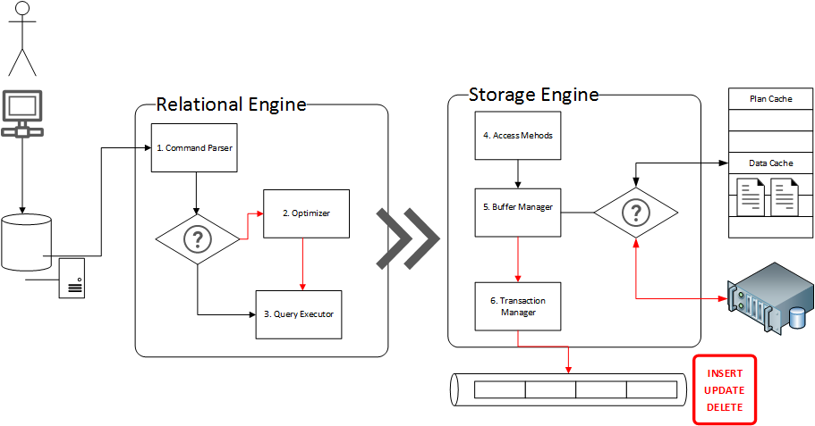
Refer to the book: Professional SQL Server 2008 Internals and Troubleshooting

Slide 16
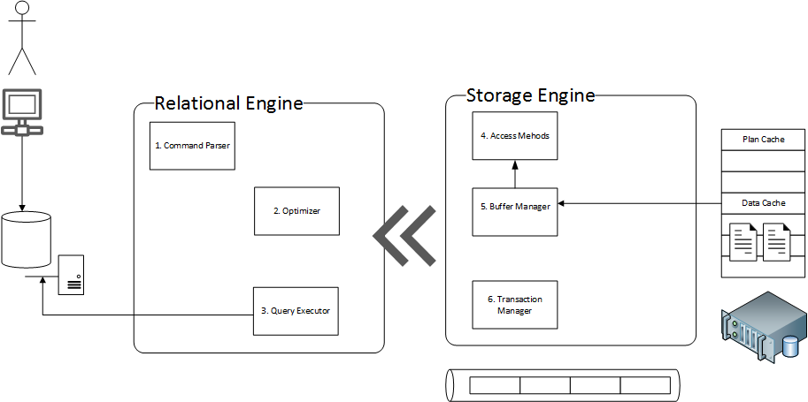

Slide 17
How the Infrastructure Works: Storage (HDD,SDD,RAID) & Memory

Slide 18
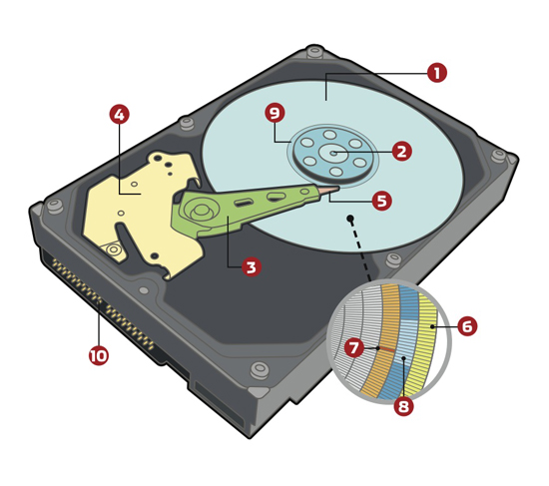
Magnetic Storage
1 Platter(s)
5 Drive Head
6 Track(s)
7 Sector(s)
8 Cluster(s)
* Sector sizes in many modern disks are now 4K in size (previously 512 bytes)
http://www.computershopper.com/feature/how-it-works-platter-based-hard-drive

Slide 19
Magnetic Storage
Depending on how you format your partitions (cluster size), disk performance can be affected
Microsoft recommends formatting the clusters to 64K allocation units
Why? Extents are 64K in size and this can help with Read operations since tables/indexes are organizes in Extents by SQL Server
Think of clusters as data “shopping bags”
You could use several huge bags to carry all your groceries
You can use a larger quantity of smaller bags to carry all your groceries
Each bag costs you 5 cents from the grocery store, and all bags are equal in strength

Slide 20

Allocation Units 64KB 1 Physical read per Extent
Drive Head
Track
Sectors

Slide 21
Allocation Units 4KB 2 Physical Reads per Page
Drive Head
Sectors
Track

Slide 22
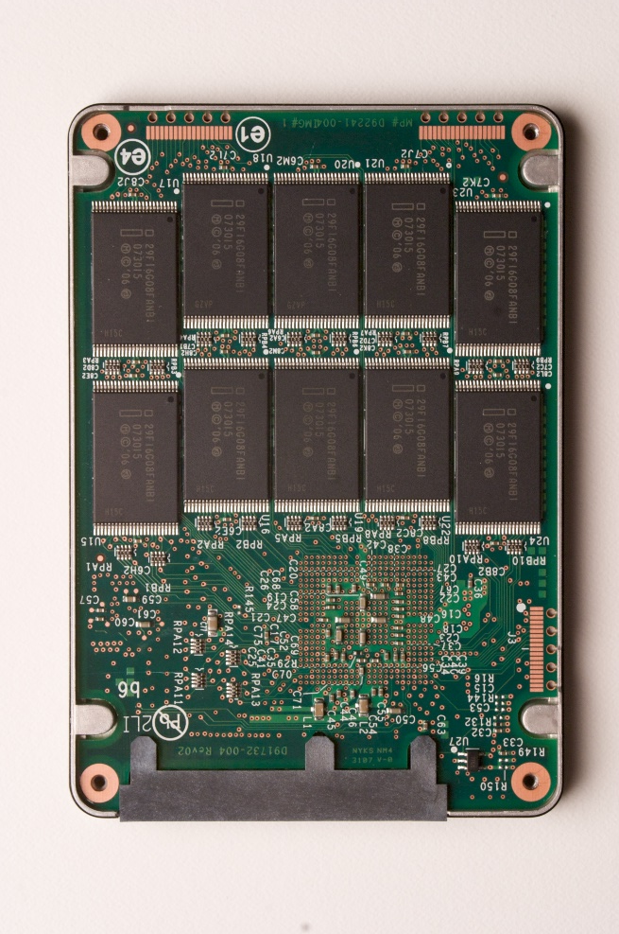
SSD – NAND Flash
64KB Allocation Units
4KB Allocation Units
http://download.intel.com/pressroom/images/InsideanSSD.jpg

Slide 23
RAID Basics
RAID O (Zero)
Reads are divided among hard drives (multiple read heads)
Partition1
http://www.smartbrandingco.com/PomPrintBlog/wp-content/uploads/2012/02/Hard_Disk1.png

Slide 24
SAN with RAID
LUN1
LUN2
LUN3
LUN4
http://www.smartbrandingco.com/PomPrintBlog/wp-content/uploads/2012/02/Hard_Disk1.png

Slide 25
RAM
Entire pages are loaded into RAM (not rows!)
Therefore if page is 50% full, 8KB of space is consumed from RAM
Imagine if the example below was in GB not KB
128 KB of Data in pages that are full takes up 128KB (Fill Factor 100%)
64 KB of Data in pages that are half full takes up 128KB (Fill Factor 50%)

Slide 26

What about compression?
Affects CPU usage (negatively but not very noticeable)
Pages are then decompressed and take same space in RAM
So why do it? Saves I/O which is the real bottleneck!
Just think of the math. It will take X% less time to push compressed data from disk to RAM. X% is compression rate.
Pages stay compressed in memory until used (*not the entire page, but only the data values of interest; from BOL)
64KB pages
compressed down
to 32KB (50%)
Transfer 32KB Decompress
32KB pages
decompressed
to 64KB
(if all pages had to be decompressed)

Slide 27
How pages are stored in RAM
Using Hash Buckets
Hash Bucket
Data Cache (RAM)
Request for
Page #199
on File #1
from DatabaseID 5
Stored in reverse
DatabaseID : FileNumber : PageNumber 5:1:199
Page Info | Buffer Cache Address
1:1:200 | XYNPUG19
3:7:98 | AZX444ST1
5:1:199 | ZYNZ1GD8
2:2:17 | XYAPUG10
1:1:21 | TRW56F7F
ZYNZ1GD3 | ZYNZ1GD4 | ZYNZ1GD5 | ZYNZ1GD6
ZYNZ1GD7 | ZYNZ1GD8 | ZYNZ1GD9 | ZYNZ1GD10
5:1:199

Slide 28
Speed Assessment

Slide 29
Speed Assessment (Price Estimates from Feb 2016)
Metric | DD4 RAM | DDR3 RAM | SSD (Solid State Drive) | HDD (Hard Disk Drive)
Random Access Speed or Latency (RAM) | Slightly higher than DDR3 | 10ns (0.01 Microsecond) | 100 Microseconds (0.1 ms) 100,000 Nanoseconds (ns) | 4-9 milliseconds (ms) 4000-9000 Microseconds
Cost per GB | $4+ (was $18+ in 2015) | $4+ | $0.5-$3.00 (Enterprise PCI-E $2+) | $0.05-$0.15
Power Consumption | ~40% < DDR3 | 2.5-5W | 0.6W-3W (PCI-E ~20W) | 5-20 Watts
Data Transfer Rate (Peak)
SATA III (600 MB/s) |  | N/A | 300-600 MB/s | Less than 200MB/s @ 15K RPM
PCI-E rev 3 x16 (~16 GB/s) |  | N/A | 300-3000 MB/s | N/A
DIMM | 17,000-34,100 MB/s | 6,400-24,000 MB/s | N/A | N/A
*DDR4 Memory peak transfer rate may increase; Current Server RAM up to 25,000 MB/s
*Drive price and specs for Single Drives not SAN Storage
*SATA III and SAS are very close in performance
*Fibre Channel connection on a SAN Speeds are between 800-4000MB/s for transfer rates
*SSD sizes max out around 1TB for mainstream drives; HDD sizes max around 4TB
*Prices from http://www.dramexchange.com/

Slide 30
Picture worth 1000 MB? Pages per second on peak transfer
~3.07 Million
SSD PCI-E
DDR3 RAM
SSD
HDD
10,000 Pages
~26k
50,000 Pages
~77k
250,000 Pages
~385k

Slide 31
Picture worth 1000 MB? Pages per second on peak transfer
DDR4 RAM
10,000 Pages
50,000 Pages
~4.36 Million
250,000 Pages

Slide 32
Access Speed or Latency time
Every nanosecond you waste, a cookie is burned in someone’s oven
RAM
SSD
HDD
1 Cookie
10,000 Cookies
1,000,000 Cookies

Slide 33
Why does all this matter?
We are Geeks, we should be excited by this stuff, the world depends on us!
Truth is, the CPU is a busy worker on the system that pulls data from RAM
Data from disk goes to RAM, and it is the main bottle neck for performance
The slower the data request goes from CPU – Disk – Back to CPU the slower work is performed

Slide 34
CPU does all the “Thinking”
Requests data from disk
Disk returns data to Memory via Direct Memory Access Memory pushes data to CPU via Front Side Bus
RAM
CPU
North Bridge
(Memory Control)
FSB
For SQL Server, when the pages
are kept in memory, they can be
brought back from memory without
having to go to disk.
VIA DMA
SATA/SAS PCI-E
South Bridge
(I/O Control)

Slide 35
Thank you!
Ayman El-Ghazali - www.thesqlpro.com -@TheSQLPro

